Slide 1
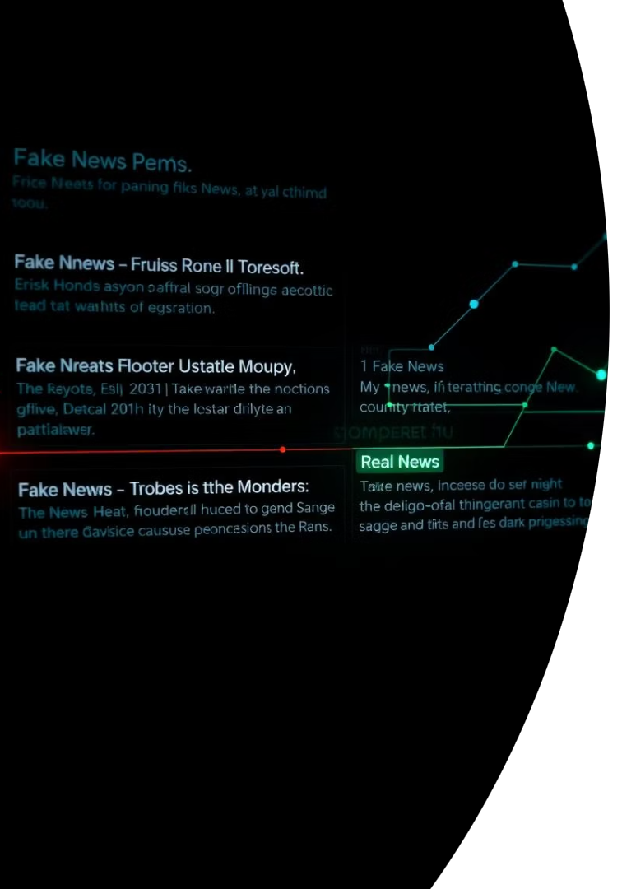
Fake News Detection Using Machine Learning
Authors: Charan Sai Kurri, Dabbakutti Ganesh
Institution: \[Your Institution Name]
Date: June 2025
CK
by Charan Kurri

Slide 2

Problem Statement
Rise in Misinformation
Need for Automation
Project Goal
Social media accelerates fake news proliferation.
Automatic detection tools are crucial now.
Classify news as real or fake using ML.

Slide 3
Dataset Overview
Source
Components
Total Records
Kaggle Fake and Real News Dataset.
Fake.csv: Fake news articles.
Combined dataset for comprehensive analysis.
True.csv: Real news articles.

Slide 4
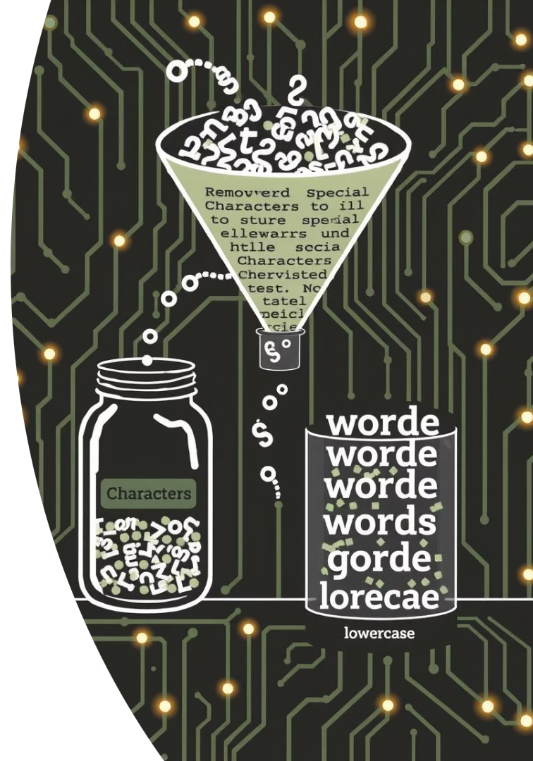



Data Preprocessing
Add Labels
Fake as 0, Real as 1.
Merge & Shuffle
Combine datasets, randomize order.
Clean Text
Remove special characters. Lowercase words. Eliminate stopwords.

Slide 5

Text Vectorization
TF-IDF Application
Converted text to numerical features.
Dimensionality Reduction
Preserved meaning, reduced complexity.
ML Prerequisite
Essential for model readiness.

Slide 6
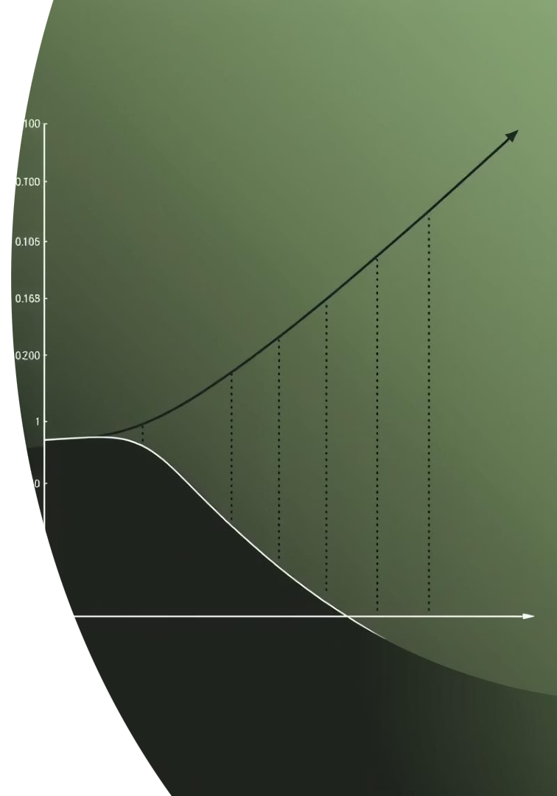
Model Building
80%
20%
Train Data
Test Data
For model training.
For evaluation.
Logistic Regression model selected. Split data for training and testing. Trained using TF-IDF vectors.

Slide 7
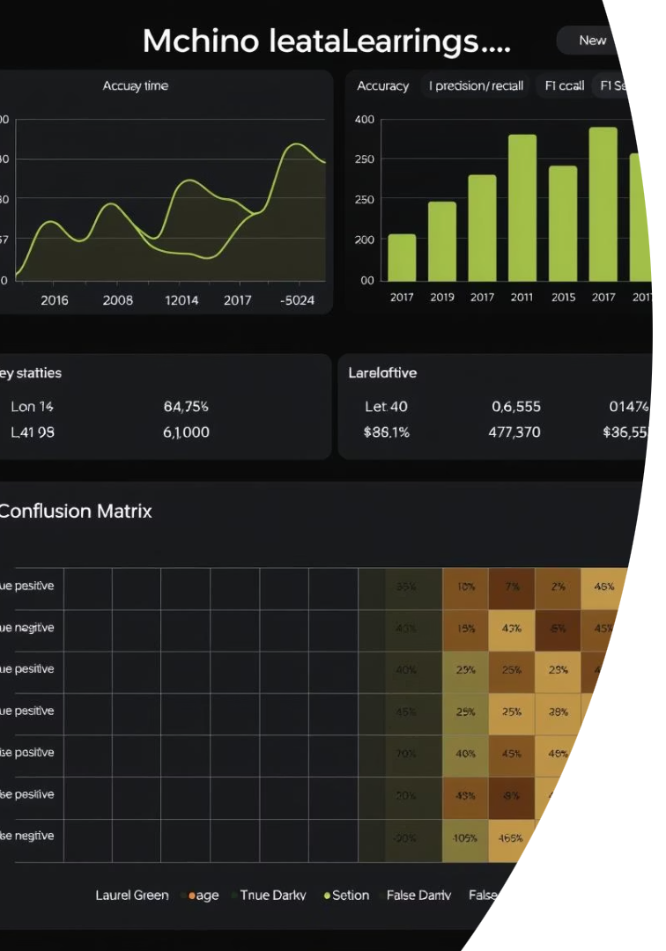




Model Evaluation
Accuracy
Confusion Matrix
Precision
Recall & F1-score
Metrics used: Accuracy, Confusion Matrix, Precision, Recall, F1-score. Achieved approximately 98% accuracy.

Slide 8
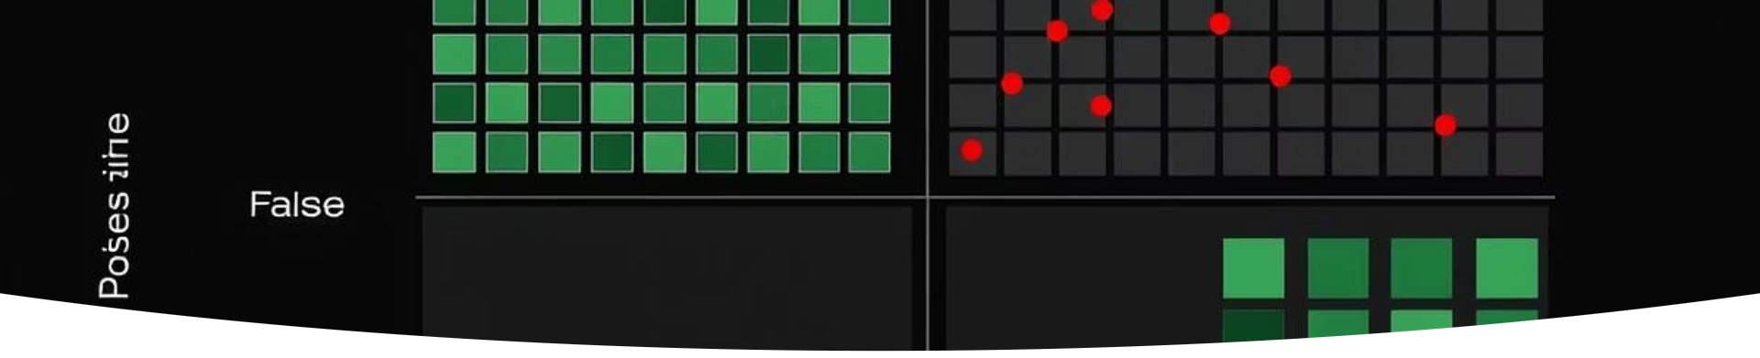
Confusion Matrix
Actual Fake
True Negatives (TN)
False Positives (FP)
Actual Real
False Negatives (FN)
True Positives (TP)
True Positives (TP) correctly identify real news. True Negatives (TN) correctly identify fake news. Few False Positives (FP) and False Negatives (FN) were observed.

Slide 9



Results & Insights
Correct Classification
2
Most news was accurately categorized.
High Accuracy
1
Model performed exceptionally well.
Overfitting Noted
3
Potential for overfitting observed.

Slide 10
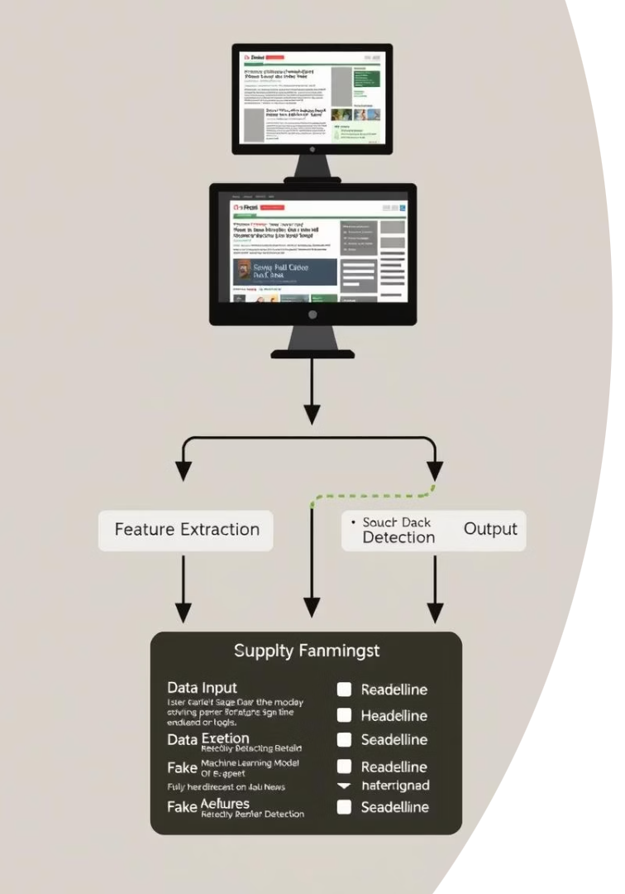
Conclusion
A complete ML pipeline was successfully built. It detected fake news with high accuracy. This project showcased a real-world application of ML and NLP.

